Slide 1
Finance Session for Year in Industry Students April/ May 2017
Sarah Metcalf
Financial Aid
Joanie Carlyle
Work Placement- Careers
Christian Bodden
LUU

Slide 2
Today’s Session
Introductions & your plans for your placement year
Advice on applying for your student loan
Information on tuition fees and maintenance loan
Unpaid placements in the voluntary or public sectors- possible financial support
Travel Grant
Working in London
Working abroad
Accommodation
LUU support
Your Placement Year guide

Slide 3
Student Finance for a Placement Year in 2017/18
Sarah Metcalf – Student Finance Advisor
Student Services Centre
Level 9, Marjorie and Arnold Ziff Building
University of Leeds, LS2 9JT
Email: funding@leeds.ac.uk
Phone: 0113 343 2007

Slide 4
What funding will I receive from my loan provider?
What do I need to do to get the correct funding?
The funding figures quoted here are from Student Finance England (SFE).
If your loan provider is Student Finance Wales (SFW), Student Finance Northern Ireland (SFNI), or Student Awards Agency Scotland (SAAS), please contact funding@leeds.ac.uk for information on your funding package.

Slide 5
If you will be on a year in industry,
working in the UK or abroad
your tuition fee and your funding
will change for the year you are away.
See the SES website for more information and downloadable fact sheets on student finance and how to complete your loan application.
http://students.leeds.ac.uk/info/21518/study_abroad_and_work_placements

Slide 6
Tuition Fees
All home rated and EU students who started University between September 2012 and September 2016 will be charged a tuition fee of:
£1,350
The Tuition Fee for international students will be £4,000
Tuition fees will be paid directly to the
University of Leeds as usual.

Slide 7
Maintenance Loan
Students on the Erasmus programme (Europe) are eligible for means-tested funding and could get the Travel Grant.
Students on a ‘special case’ work placement are eligible for means-tested funding and could get the Travel Grant if abroad.
Students who are non-Erasmus or not on a ‘special case’ work placement are eligible for reduced funding only and cannot get the Travel Grant.

Slide 8
Special Cases – Definitions
a) unpaid service in a hospital, NHS trust, or with a clinical commissioning group;
b) unpaid service with a local authority relating to the care of children and young persons, health or welfare or with a charity carrying out activities of a like nature in the UK;
c) unpaid service in the prison or probation service;
d) unpaid research in a UK or overseas institution;
e) unpaid service with a Special Health Authority or Health and Social Services Board;
f) unpaid service with either House of Parliament.

Slide 9
Maintenance Loan – Means-tested Funding
Erasmus Work Placement
‘Special Case’ Work Placement
*The ‘Parental Home’ rate will apply to students living with parents in London.
Loan Provider | Amount Not Depending on Household Income | Amount Depending on Household Income | Total Possible
SFE | £4,667 | £2,513 | £7,180
Where residing | Amount Not Depending on Household Income | Amount Depending on Household Income | Total Possible
Parental Home | £3,124 | £1,682 | £4,806
London* | £5,481 | £2,951 | £8,432
Elsewhere | £3,930 | £2,113 | £6,043

Slide 10
Maintenance Grant – Means-tested Funding
The grant is available to means-tested students with a household income of £42,641 or less. The amount of grant is proportional to the household income. No grant is payable if the household income is above £42,641.
The maximum amount of grant is £3,482 and is payable where the household income is £25,000 or less.
For every £1.00 of maintenance grant paid, the maintenance loan is reduced by £0.50 (i.e. part of the loan is converted into grant).
Non-Erasmus and non-‘special case’ students are not eligible for means-tested funding and cannot receive the grant.

Slide 11
Student Finance – Travel Grant
SFE Students:
You must be means tested in order for your loan provider to check your eligibility to apply for the Travel Grant. The award you receive depends on the household income assessment.
Be aware that you may not receive the total amount of your claim.
If you are eligible, SFE will send you a Course Abroad Form. This must be authorised by the University of Leeds. You will need to provide all your term dates, including your Christmas and Easter breaks.
You will also receive a Travel Grant Claim Form from SFE, which you should complete and return direct to SFE with your receipts (do keep copies).
SFW, SFNI, and SAAS students should contact their loan provider to request a Course Abroad Form and Travel Grant Claim Form.

Slide 12
Maintenance Loan – Reduced Funding
Work placement (non-Erasmus and non-‘special case’) students receive a reduced maintenance loan only:
*The ‘Parental Home’ rate will apply to students living with parents in London.
Where residing | Maximum loan
Parental Home | £1,915
London* | £3,585
Elsewhere | £2,553

Slide 13
University Support
ALL students
You will not receive Leeds Financial Support (LFS) during a placement year.
If you are in receipt of an Educational Engagement scholarship, you will need to check with EducationalEngagement@leeds.ac.uk

Slide 14
Placements in London
You can apply for a Student Oyster Card.
When you apply online for an Oyster Card, the Student Services Centre will confirm your registration as part of this process.
The Oyster Card application is at:
https://photocard.tfl.gov.uk/tfl/registerApplicationStart.do?est=placement&mode=init

Slide 15
Placements Outside Leeds, Bradford, Wakefield and Kirklees
Make sure that you update your ‘term time’ address on the University Portal.
If you will be living in in Leeds, Bradford, Wakefield, or Kirklees, the University will confirm with the Council that you are a registered student and you should not receive a Council Tax Bill.
If you will be living anywhere else in the UK, you can apply for Council Tax Exemption.
You will need a Confirmation of Registration letter from the Student Services Centre to apply for Council Tax Exemption.
The Council Tax Exemption link is:
http://www.leeds.ac.uk/studentservicescentre/counterservices/counciltax.htm

Slide 16
Applying For Your Student Loan
You can apply online for your student loan from 22nd February. You will need to complete the application with all the details of your placement year and you must check/enter the following:
your correct 4 year course title – Course Name (IND)
the end date of your course (taking account of the additional year)
the correct tuition fee
where you will be for each term
the name of the work place
the country
if you will be part of an Erasmus programme

Slide 17
Applying For Your Student Loan

Slide 18
Applying For Your Student Loan

Slide 19
Your Student Finance Application for 2017/18
Please be aware that your loan provider will update your record, and calculate your funding entitlement, from the information on your application form.
The University does not send details of your placement to your loan provider unless specifically requested to do so in writing by the loan company.

Slide 20
University Insurance Policy
Summary of Cover Document
The Summary of Cover document should be printed and taken with you. Find this at: http://www.leeds.ac.uk/insurance/travel.htm
Confirmation of Cover
If you require a letter to confirm you have University of Leeds insurance for a visa application, please email, insurance@leeds.ac.uk or phone 36029, providing details of your full name, department, destination and dates of trip. You will receive the necessary document by return.

Slide 21
What YOU Need To Do Now
Complete your student loan application as soon as possible.
If you do not have all the details of your time away when you apply, you can enter “to be confirmed” and update at a later date using the ‘Change of Circumstance’ (CO1) form, downloadable from your account.
When you receive your ‘Financial Notification’ letter you must sign your ‘Declaration Form’ and return it your loan provider as soon as possible. They will not release any payments until they have this.
You must still register online with the University of Leeds for the 2017/18 academic year. You will not be covered by the University Insurance Policy if you are not registered.
University online registration will be possible from the 1st August 2017.

Slide 22
Help While You Are Away
Set up a Professional Password
If you have an issue with your student loan, the University can only speak to your loan provider if you have set up a Professional Password. It is much easier to do this before you go on placement, even though you might not need to use it.
We strongly advise that every student going on placement sets up a password.
The instructions for setting up a password can be found on the SES website http://students.leeds.ac.uk/info/21518/study_abroad_and_work_placements
If you set up a password, keep this safe and pass it on to Student Funding if you do need help.

Slide 23
Income Tax & National Insurance (UK)
Tax free personal allowance (this is the amount you do not need to pay tax on)
Tax year: 6th April 2017 to 5th April 2018:
personal allowance = £11,500
https://www.gov.uk/income-tax-rates
Your placement is likely to fall into two tax years
If you overpay tax you can claim this back from HRMC.
https://www.taxguideforstudents.org.uk/tax-refunds
National Insurance (NI): will be paid if you earn more than £157 per week:
https://www.gov.uk/national-insurance/how-much-you-pay
If due, Tax & NI is usually deducted automatically through the PAYE (Pay as You Earn) system by your employer before you receive your salary.

Slide 24
Looking for Accommodation?
Try your employer first
Use your networks
Useful websites:
www.spareroom.co.uk
www.gumtree.com
www.zoopla.co.uk
www.housinganywhere.com
www.unite-students.com
https://www.airbnb.co.uk (short term rentals)

Slide 25
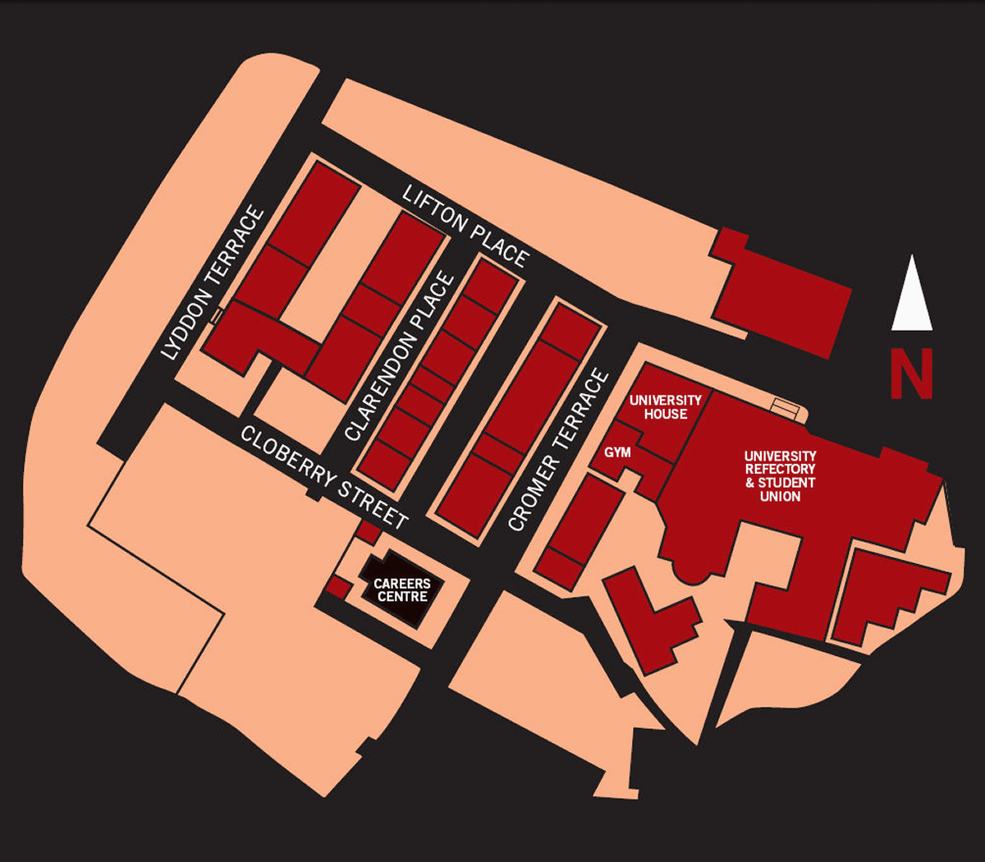
Where to find the Careers Centre…
Drop in 1pm – 4pm Monday to Friday
CVs, applications, interviews, assessments.
Employer events
Internships

Slide 26
Leeds Internship Programme
Exclusive to University of Leeds students Summer, placement year & part time, term time
All paid a minimum of £300 per week
For the latest vacancies & to register:
https://mycareer.leeds.ac.uk/
And click the Leeds Internship Programme tab at the top of the page

Slide 27
Notes:
Your placement year guide
University wide resource
Supporting students throughout the placement process
Compliments School and Faculty support as well as support offered by Student Careers
Information, advice and support including videos of students, staff and employers sharing their advice
Interactive – it includes discussion boards and Collaborate session (staff led discussions) – an opportunity for students to meet others in a similar position to them
Available via the VLE use the link http://students.leeds.ac.uk/yourplacementyear. To access the guide staff and students should enrol via this link. Once you have enrolled you can re-access the guide either via this link or the guide is listed under the ‘Organisations’ tab on the VLE.
The guide is in 4 sections
Securing your placement (may be of particular use to Year 1 + 2)
Planning and preparing for your placement (may be of particular use to Year 1 + 2)
Support during your placement (may be of particular use to On placement)
Finishing your placement – Returning to University (may be of particular use to Final Year)
(Students will still find the guide useful if they are looking for internships or other types of work experience).
You may also find it useful to play the introductory animation which is hosted under the ‘Getting Started’ tab of the guide (in the left hand navigation at the top) to give students a better insight into the guide.

Slide 28
Your Placement Year Guide
University wide resource
Supporting students throughout the placement process
Information, advice and support including videos of students, staff and employers sharing their advice
Interactive – it includes discussion boards and Collaborate session (staff led discussions) – an opportunity for students to meet others in a similar position to them
Available via the VLE use the link http://students.leeds.ac.uk/yourplacementyear
To access the guide students should enrol via this link
Once you have enrolled you can re-access the guide either via this link or the guide is listed under the ‘Organisations’ tab on the VLE.
Notes:
*Play introduction video

Slide 29
ACCOMMODATION
Use workplace contacts
Useful websites:
www.spareroom.co.uk
www.unite-students.com
www.loot.com
www.gumtree.com
www.zoopla.co.uk
www.housinganywhere.com
Leeds University Union.
Christian Bodden
Student Advisor

Slide 30
LUU Student Advice Centre
Can advise on :
Money Housing
Academic Welfare
Level one in the Leeds University Union building on campus
0113 380 1290
advice@luu.leeds.ac.uk
Instant Messenger chat (to be back online in Sept 2017)
Email and telephone advice- appointments as well as general enquiries
https://www.facebook.com/leedsuniversityunion
https://twitter.com/leedsuniunion

Slide 31
Useful contacts
If you have any questions regarding your funding or your application for your student loan then you can contact the funding team as follows:
funding@leeds.ac.uk or telephone 0113 343 2007
or call into the Student Services Counter in the Ziff building
**************************************************************
Erasmus+ funding queries: Angie Willshaw (based at the Careers Centre)
Email: erasmuswork@leeds.ac.uk
Tel: 00 44 (0) 113 343 7104
http://careerweb.leeds.ac.uk/info/3/working_abroad/174/erasmus_programme
*****************************************************************
The Careers Centre: http://www.leeds.ac.uk/careerweb/
5-7 Cromer Terrace, University of Leeds
Telephone: 0113 343 5314
Email: workexperience@leeds.ac.uk
*

